Slide 1

Modernizing your Building Management System (BMS)
Creating sustainable, efficient, and cyber secure building operations
Notes:
One of the consequences of the Covid-19 pandemic has been a focus on the role of buildings. As more people work
from home, building owners are looking for ways to adapt and innovate.
In this new environment, those owners are seeing low occupancy levels for hotels and offices, but high demand
requirements for critical facilities. Interestingly, despite what might be characterized as a once-in-a-generation
societal shift, forecasts still project that building stock will continue to grow — from 102.9 billion square meters in
2019 to 183.5 billion square meters by 2026.
Moreover, we are seeing that the electrical and digital transformations that were already underway are now going
into overdrive.
Both building owners and facility managers are facing the challenge of doing more with fewer resources. They need
to ensure cybersecurity, enable remote operations, and improve the use of space — all while reducing energy costs
and supporting their sustainability goals.
To survive — and, indeed, thrive — in this new environment, you will need to tap into the power of the all-digital,
all-electric world with a more sustainable, more resilient, more efficient, and more people-centric building. This is
where Buildings of the Future comes in.

Slide 2


The four pillars of a Modern Building
Sustainability
~40% of global CO₂ emissions comes from operational energy use
>30% of building
energy is wasted
Resiliency
38% of BMS
are impacted by cyberattacks
Hyper-efficiency
+1.4% increase in global productivity as a result of advances in automation and technology
People-centric
~90% of our time is spent in buildings
Notes:
Let’s look at the four pillars on which Buildings of the Future are based.
CLICK
The first is sustainability, which we have already alluded to. Buildings must adapt to new directives in order to get
new certifications such as LEED, WELL, Fitwel.
What’s more, facility managers need to track metrics related to carbon savings and “green” KPIs, including
integration of on-site renewable energy resources. IP-based products have exploded onto the marketplace of late to
answer this need. It’s clear that buildings will need to participate in active energy management to achieve more consistency and
efficiency.
CLICK
Next, we have resiliency.
Elevating building management to the cloud means facility managers must ensure systems are cybersecure and
meet all the latest standards to avoid malicious attacks.
Another result of the pandemic has been a reduction in the number of on-site facility managers, making remote
access to and control over building systems more critical than ever.
CLICK
The third is hyper-efficiency.
While new tools do empower facility managers to drive business revenue, limited budgets, and fewer skilled people
to operate systems, there is a need to manage technologies and tasks even more efficiently than before.
Similarly, there is a need to also improve operational efficiency by using automated tools to help move from
planned preventive maintenance to a more proactive approach.
CLICK
The last pillar for Buildings of the Future is people-centric.
Here, the comfort, health, and wellness of your buildings’ occupants becomes a value-added differentiator.
Additionally, hybrid working models are becoming more common, and so office space and infrastructure must be
flexible enough to adapt to changing requirements and uses.

Slide 3

Why BMS modernization matters
Sustainability
reduce energy usage and costs, drive energy efficiencies
Resiliency
reduce cybersecurity risks, recover more quickly
Hyper-efficiency
maximize building performance through system/workflow optimization
People-centric
improve use of space, enhance occupant experience
Notes:
Modernization of your Building Management System (BMS) has numerous benefits, as you can see. Importantly, it
can help achieve the four pillars of Buildings of the Future that we just reviewed.
CLICK
With a modern BMS, for instance, you can reduce energy costs, consume less energy, and make more informed
decisions. Not only will this support your sustainability goals, but it will also drive energy efficiency and building
certifications — and will extend the life of your real estate assets.
CLICK
When it comes to resiliency, a modern BMS means a building can bounce back quickly, as a more cybersecure
platform significantly reduces the risk of cyber threats or even attacks. It also enables remote operations in cases
where there is no on-site facility management.
CLICK
A modern BMS optimizes the system and workflow and provides the tools you need to do more with fewer
resources. These tools include automating operations, real-time monitoring and performance analysis, data
integration across platforms and systems — all resulting in hyper-efficiency.
CLICK
Modernizing your BMS also allows you to improve the use of space in your buildings, enhancing the occupant
experience by creating a comfortable, healthy, and predictive environment.

Slide 4

YOUR BMS IS OUTDATED
— SO WHAT?
Notes:
Modernizing your BMS can seem quite daunting.
However, on the next slide, you’ll see some of the challenges and risks that you could face by not modernizing.

Slide 5

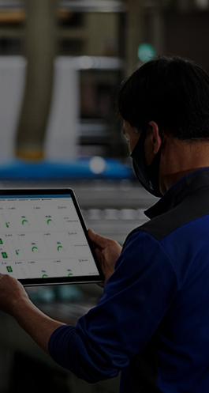

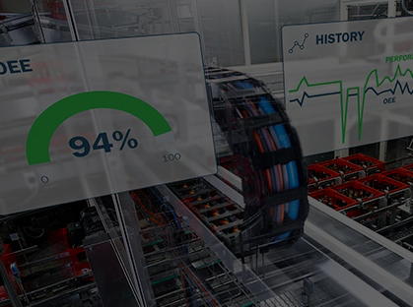



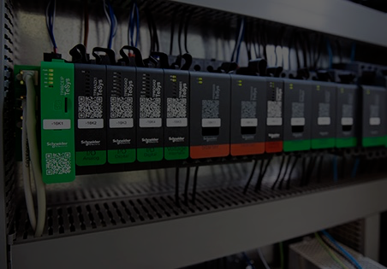


The risks of not updating your BMS
Cyber-risk
Harder to achieve & demonstrate sustainability targets
Reduced performance and functionality
Unavailability of legacy products
Frequent failure of equipment
Limited data insights
Notes:
By not modernizing your BMS system, you might be risking efficiency, productivity, and profitability.
The overall functionality of a building might be impacted, and lead to unnecessary expenditures, both in terms of time and money.
CLICK
Cyber-risk
With 38% of older buildings impacted by cyber threats, not updating your BMS might make your building a target for a malicious attack.
If your systems are outdated, they are much more at risk of cybersecurity threats and must have the latest cybersecurity standards in
order not to pose disruptive risks to overall business. Having the latest software and security updates will help you fend off threats.
The risk with our legacy systems is that we can no longer update their operating systems and so their operating systems become unsupported, by the likes of Microsoft.
Thus, they are not supporting the latest cyber security features. So upgrading to the latest EcoStuxure platform will help you fend off threats.
It’s also more and more common for Risk Management to demand your BMS be up to date.
CLICK
Unavailability of legacy product
The other significant risk of not updating of the BMS is the unavailability of legacy products for spare parts or system extensions.
Over time, the legacy system products reach their end of life as components become limited or worse unavailable.
As products near end of life during service period, costs of the components and manufacturing rise, since we are making fewer numbers, and these costs are reflected in product prices.
But in time, when failures do occur, replacement products are not available, and the risk to the having a system not functioning is very real.
CLICK
Harder to Achieve & Demonstrate Sustainability Targets
There are numerous BMS functions that can enhance economic, environmental, and social sustainability: these include energy efficiency, reduction of carbon emissions,
reduction of energy consumption, ensuring the health and well-being of occupants, and extension of building’s lifespan.
A property with a modernized BMS can easily qualify for various certifications. What’s more, a modern BMS more easily helps facility managers achieve newly created sustainability KPIs.
One of the great challenges for facility managers is to be able to demonstrate that improvements and savings have been made in a simple method for all to understand. This is very difficult to do with legacy systems.
Active energy management is only as good as the data and insights that you have: energy use, power quality, reliability, etc. Without such data,
greenhouse gas emissions can’t be measured or managed, making compliance more difficult. Today’s BMS technology provides intelligent energy
analytics to support accurate sustainability reporting, helping simplify compliance with the Energy Performance of Buildings Directive (EPBD) in Europe
or standards such as ASHRAE Standard 90.1.
Modern BMS technology advances help explain precisely when and where energy is consumed and how to optimize BMS settings — that goes way beyond just HVAC control.
CLICK
Frequent failure of equipment
An obsolete building management system can lead to frequent failure of equipment, as components start to fail more often over time.
When it comes to BMS modernization, timing is key: it is a lot more cost-effective to gradually upgrade and improve parts of the system
over time rather than replacing the entire system at the end of its life.
CLICK
Reduced performance and functionality
Also, the performance of your building might suffer by not modernizing your BMS. Especially given that more than 30% of a building’s energy is wasted.
Although the legacy systems were able to manage the energy, they do not have the modern tools and flexibilities to help implement the most effective solutions,
and so no modernizing inevitably reduces performance of the building compared to one with a modern system, such as EcoStruxure. The greater range of functionality in EcoStruxure enables the improved performance.
CLICK
Limited data insights
If the mantra in real estate is location, location, location, then the mantra in Buildings of the Future is data, data,
data. Things are moving faster towards predictive maintenance — e.g., AI — with new generation systems having capabilities
unheard of even a few years ago. More data, and more insightful data, can help you better manage and optimize
buildings, and ensure you can adapt to the changing needs of your occupants, or changing market conditions.
Legacy systems do not have this capability or functionality, and will prevent taking advantage of more data, as well as different types of data.
Add to that the fact that lack of data insights also limits efficiency and scalability, which in turn can negatively impact sustainability goals.

Slide 6

And the risk is increasing with time…
Timing is the key
Value
Keep up to date
Annually
Software obsolescence
3 to 5 years
Hardware obsolescence
~15 years
Out of service
~20 years
Criticality
Notes:
And the risk is increasing with time. While most Mechanical and Electrical Systems hold value for 15 to 30 years, building management systems software should ideally be updated every 3 to 5 years in order to ensure smooth operation and maintain building value. As you can see on the graph, the level of challenges increase criticality over time:
1. Keep up to date: Modern BMS will offer software assurance as the vendor performs continuous updates so that you can ensure you are operating with the newest version and applying the latest bug fixes, UI/UX or performance enhancements, and security updates. These may be annually, but often for bug fixes and special security features, they are often more frequent. Software Assurance models enable this challenge to be met in a structured manner to meet your opex budgets.
2. Software obsolescence: Once a vendor has stopped developing or upgrading BMS software, it will suffer compatibility issues with newer hardware (e.g., devices, PCs). Moreover, the software will fall out of standards compliance, reducing protection against cyber-attacks.
3. Hardware obsolescence: It may no longer be possible to update old technology and architectures, with no possibility for capacity expansion to support today’s needs.
4. Out-of-service risk: At this stage, system software and hardware can no longer be supported, parts become unavailable, and service expertise is hard to find.

Slide 7
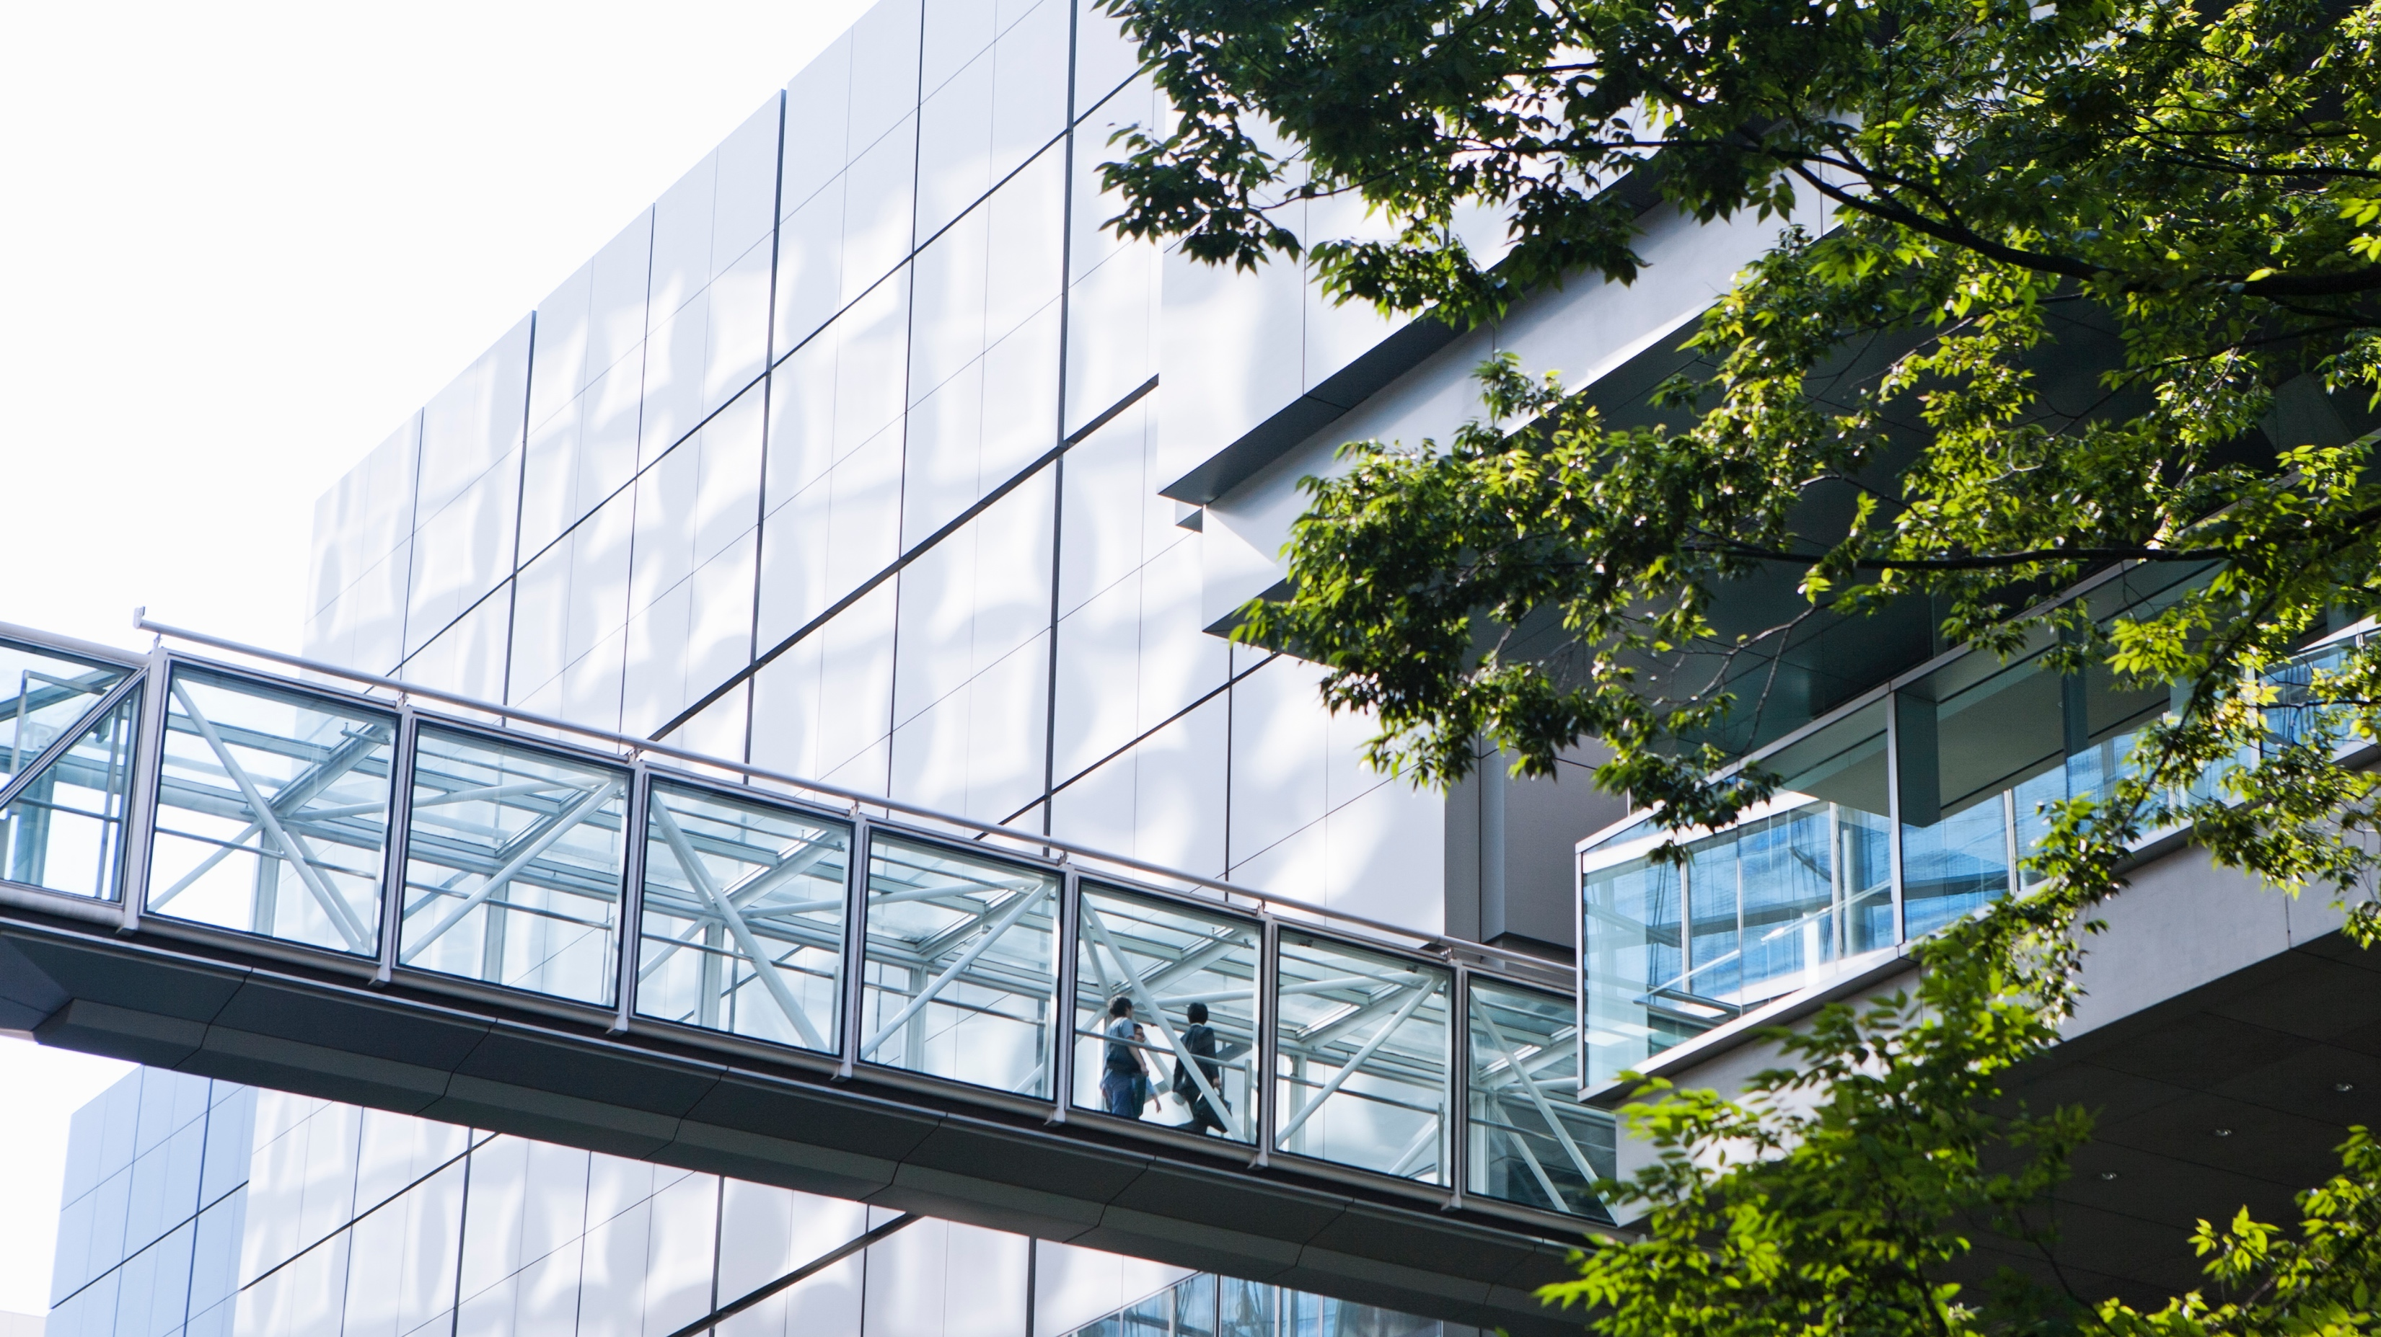
Attributes of a modern BMS
Is it designed for cybersecurity?
Does it help you meet newest sustainability requirements?
Does it provide a platform for future smart buildings?
Is it data-centric and does it give deep visualization and analytics?
Does it provide “IT agility” and is scalable?
Does it support a wide range of smart devices?
Is it flexible enough to address changing needs?
Notes:
What should a modern BMS be capable of? Let’s answer these questions!
CLICK
First, it needs to be designed for cybersecurity — following the standards and best practices for product and system development,
testing, installation, and operation.
CLICK
Next, it should help to meet all of your newest sustainability targets. A modern, next-generation BMS provides the tools needed to fully optimize
energy use and comply with growing societal pressure and governmental climate regulations.
CLICK
Smart buildings focused on people centric applications such as people counting to control plant more efficiently, or IoT sensors to provide a full view of Indoor Air Quality, require a BMS with a robust scalable IP architecture. This is not available with legacy systems.
CLICK
It should be data-centric, equipped with deep visualization and powerful analytics, intelligent functions that help you reduce operating expenses
and help your facility team identify, isolate, and respond to risks quickly without doing constant preventive checks. Data-drive: it can
communicate with other building sub-systems
CLICK
It should be able to provide ‘IT agility,’ using an easy-to-scale architecture with unlimited capacity, capable of aggregating information
from across your entire building portfolio.
CLICK
Our customers need a system that can use a wide range of smart devices including smart phones, tablets, that can provide simple effective remote access to the system via web browser or apps.
CLICK
Lastly, a modern BMS should be adaptable to changing tenant/occupant demands. With mobile apps and services, you can create a
more engaging experience and meet the needs for the space for tenants and employees.

Slide 8
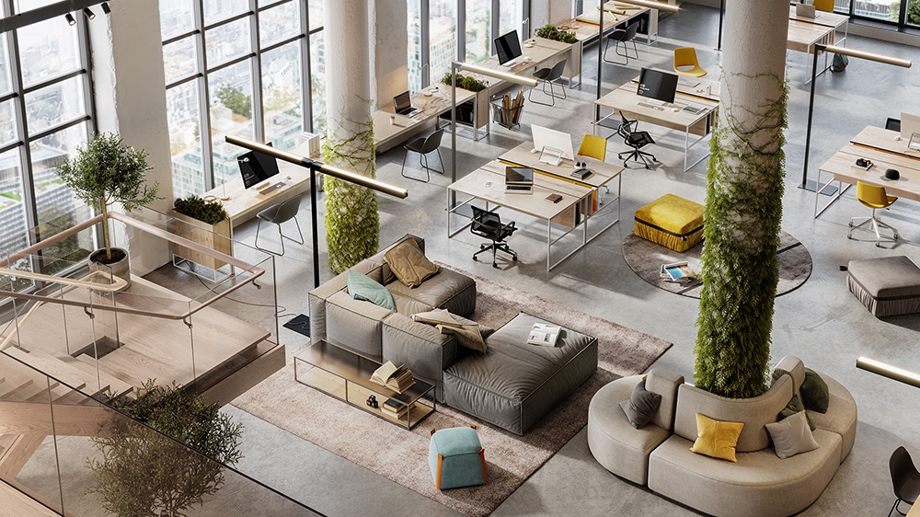
The way forward with Schneider Electric
Modernizing your BMS can be ….
Cost-effective
Simple
Identify quick and self-funding modernization opportunities
Start with a step-by-step plan
Can be achieved in a phased approach with minimal interference to business operations
Upgrading software and hardware costs less than replacing entire system
Enable reducing of maintenance costs through creation of dedicated transition plans
Seamlessly integrate new platform with third-party or native systems
Notes:
You answered the questions, and you don’t have the Modern BMS?
Don’t worry as with our solutions, you can modernize it and you can do it with the cost-effective and simple approach.
Cost-effective
Contrary to what you might think, modernizing your BMS does not have to be capital-intensive. By starting with a
step-by-step plan, you can identify quick modernization opportunities that not only optimize your investment but
will pay for themselves. In this way, you are maximizing the lifetime value of your existing system infrastructure.
It’s worth noting too that the cost of upgrading software and hardware is a fraction of the cost of replacing the entire
system. A transition maintains all the field devices and installation wiring, but more importantly enables the database and system configuration to be maintained.
And in the cases of Continuum and Xenta, maintaining of the controller programs, so preventing the requirement to re-write the application code
Front-end modernization enables you to leverage the latest technologies that optimize the operations of
your buildings so you can deliver a secure, capable, and serviceable BMS platform with minimal future upgrade
efforts. With dedicated transition plans you will be able to reduce the maintenance costs and avoid unexpected expenses.
Simple
The step-by-step plan is not only cost-effective but also reduces risk at each stage. With the plan tailored to your budget, timeline and technical needs
you can achieve modernization in a phased approach with minimal interference to business operations.
Lastly, but perhaps most importantly – you don’t need to replace your current equipment – modernization is a seamlessly integration with
third-party or native systems.

Slide 9
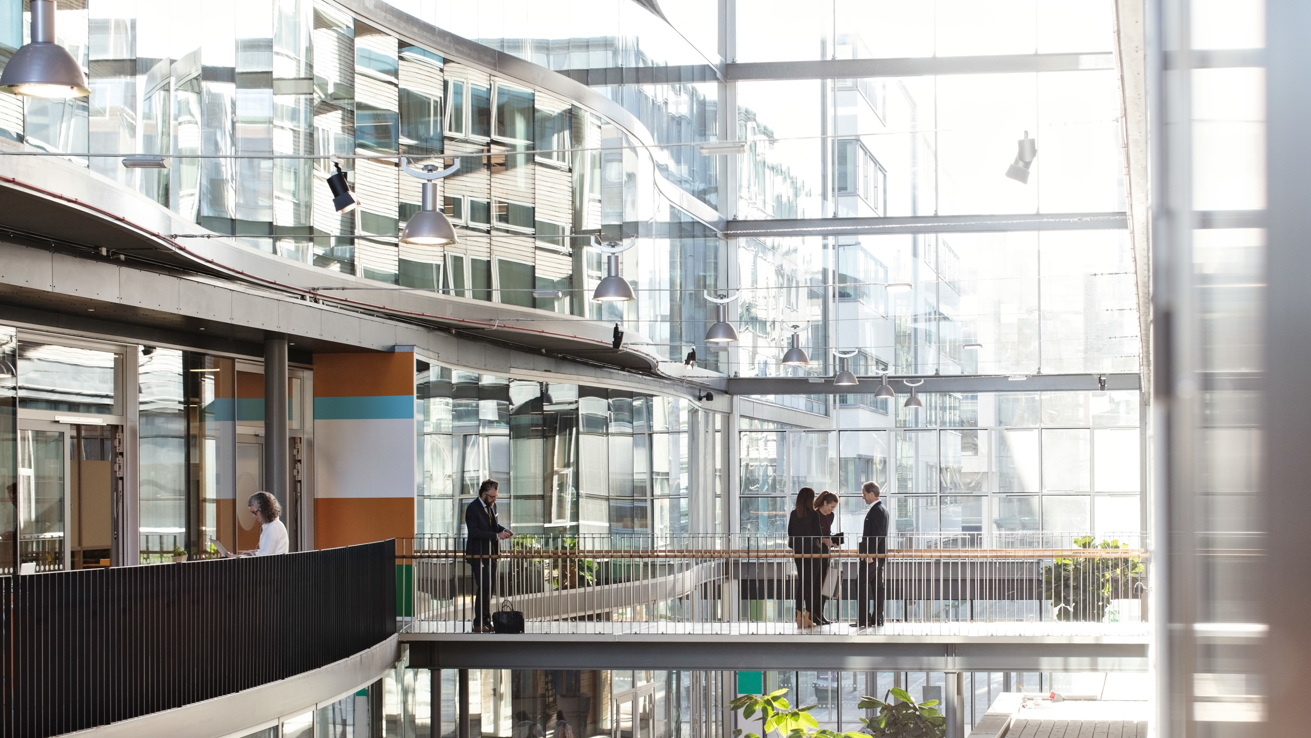
What modernizing with Schneider Electric mean?
Getting EcoStruxure™ Building Operation 2022 that is:
Open
Maximize opportunities with end-to-end IP solution
Scalable
Improve operational efficiency
Automated
Simplify support and troubleshooting
Data-centric
Deliver deeper insights and tighter control
Cyber-secured
Provide best-in-class cybersecurity
Property of Schneider Electric |
Page 9
Notes:
The benefits of modernizing with EBO are clear:
It will help you maximize opportunities with an end-to-end IP solution. With EBO, you can take advantage of the
latest IP-enabled hardware and software for faster and more reliable communication and better data. An open
platform means easy system-to-device integration with new automation servers and field devices or existing
third-party hardware.
It will improve operational efficiency. You will be able to better manage and indeed optimize your buildings with
features that save both time and effort. For instance, you can automate your operations with anywhere/anytime
access to reports, scheduling, advanced alarms, SMS notifications, and zoning presets.
EBO will allow you to simplify support and troubleshooting. You’ll be increasing engineering efficiency and lower
maintenance costs using the built-in system analytics to monitor and report BMS health data across multiple
systems and portfolios. As part of your contract, the software will always be kept up to date.
You’ll gain deeper insights and tighter control. Imagine getting the visibility you need to better manage and optimize
building assets. Imagine getting faster access to navigation, “enterprise central” portfolio-wide views, and
comprehensive reports, historical data, trends, and schedules. Imagine using customizable charts and graphs to
convey massive amounts of data to diverse audiences. Or using personalized kiosks and enhanced dashboards to
see the status of a whole building or single piece of equipment. Imagine receiving alarm notifications with detailed
reports or utilizing sensors/systems integration and automated asset control to improve occupant comfort. This is a
genuine experience, letting you access the system from smartphones, tablets, or laptops.
You can count on best-in-class cybersecurity. We’ve already talked at length about how vital it is to protect yourself
from cyber-attacks. With EBO, all software, hardware, and systems are cyber secure and follow a secure development
lifecycle, with third-party certification of standards compliance. This security encompasses the transport layer,
object level, email, passwords, access control, and much more.

Slide 10

Transitioning from legacy lines to EcoStruxure™ Building Operation
Your three-step path to modernization
1
2
3
Create
a plan
Replace legacy software
Replace legacy hardware
Notes:
At Schneider Electric, we can help ensure that your move from legacy lines to a modern BMS is seamless.
It is tailored to your specific needs, and is defined by your timeline. In short, our EcoStruxure™ Building Operation can fulfil the these promises.
The path we travel together can be short- or long-term depending on the specifics of your building.
To achieve a cost-effective solution, there are three simple steps you must take to transition your existing BMS to
EBO.
[Read bullet points]
Let’s dive a little deeper into each of those steps now.

Slide 11

Step #1: Create a plan
Your plan should consider:
Your budget
Your current operational needs
Your future expansion plans
Any contingencies
Spare parts needs
Timing it the key when creating your customized modernization plan
Value
Keep up to date
Software obsolescence
Hardware obsolescence
Out of service
Criticality
Notes:
Step one is creating a comprehensive site-transition plan. This plan will be customized for your building’s budget and
technical needs, and will review the overall control strategy, operational needs, and, of course, future expansion
plans for the building. It will also include contingencies as well as a strategy for managing spare parts.
The plan will also include defining the schedule, the budget, KPIs, the desired outcome, and an estimation of savings
that will be achieved through modernization.

Slide 12

Step #2: Replace legacy software
Upgrade your front end to EBO keeping controllers as-is:
Let’s you reap benefits from start
Helps maximize ROI on existing hardware
Prepare plan for hardware modernization before end of service.
Notes:
To manage any cyber vulnerabilities, the first stage of upgrading is to install new BMS software and associated
network upgrades.
Retain and integrate with existing legacy field controllers to preserve investments.
Naturally, you want to avoid any disruption, so it’s reassuring to know that legacy and new BMS software can run
both separately and simultaneously. Any new builds or refurbishments will have the new BMS software installed.
Ensure a spare parts inventory to keep other building areas operating as changes are phased in. Optionally, replace
legacy hardware.

Slide 13
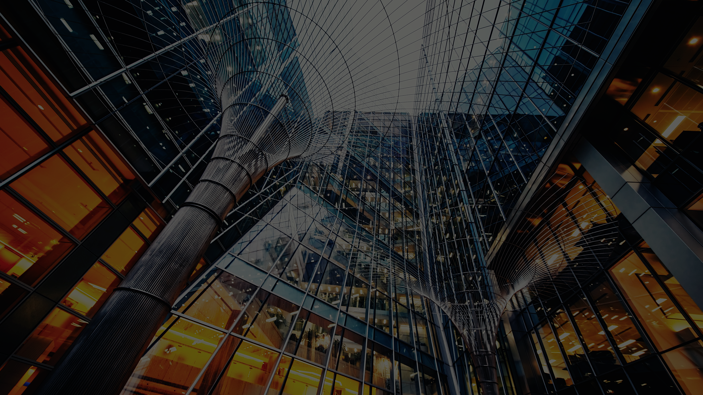
Step #3: Replace legacy hardware
Process can be phased depending on your specific replacement strategy:
Upgrade by network branch
Upgrade by hierarchy – plant/zone
Ad hoc field replacement as needed
Outcome
Future-ready buildings with connected products and services will increase in value
And the most importantly…
The front-end replacement is backward compatible – it can seamlessly integrate into existing hardware, avoiding the need to replace existing controllers and devices
Notes:
By this step, we already have a defined budget and agreed-upon schedule. And so, we can swap controllers and
devices with the latest technology over the planned period.
One thing you may want to consider is dividing your building’s assets into quadrants, with those quadrants upgraded
one at a time. One key benefit of this is that older devices that have been removed can be used as spares for the
remaining quadrants until the budget or schedule allows for complete replacement of all field devices.
The overall result of creating buildings with connected products is that your building or buildings will become more
attractive to potential tenants, and therefore likely increase in market value.
And the most important thing – the front-end replacement is backward compatible.

Slide 14

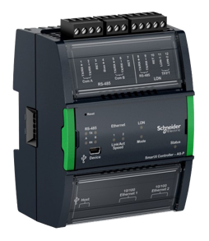
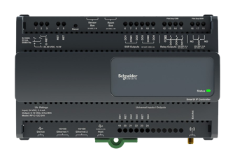
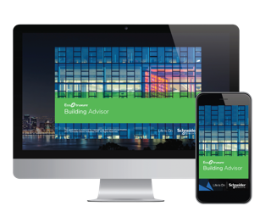
Connected products, connected services
SpaceLogic Automation Server
SpaceLogic Room Purpose Controller
Adding Building Advisor platform will:
Flexible for both larger and smaller buildings
Scaled pricing
Satisfies network security requirements
Guaranteed cybersecure, from factory to installation
More advanced integration capabilities
Helps create future-ready space
Remains connected to installed base with transition and replacement options in MSTP networks
Provides platform for IAQ and demand driven ventilation
Features improved power provisions
Help design your building’s future
Simplify maintenance
Improve comfort
Optimize performance
Extend asset life
Notes:
For those looking to boost their buildings’ values — which is probably everyone — the key is to ensure you have both
connected products and connected services. Key products in the transitions are the SpaceLogic Automation Server and Room Purpose Controller.
They have multiple benefits and help to improve the value of your facility.
With a modern BMS comes the opportunity to access additional platforms. One such platform, trusted by countless
customers, is called Building Advisor, which helps design the future of your building.
The main benefits of Schneider Electric’s Building Advisor platform are that:
It simplifies maintenance, prioritizing issues that need to be fixed based on their impact on energy, comfort, and
equipment.
It improves comfort by identifying any IAQ issues that might lead to discomfort or an unhealthy environment.
It optimizes performance by detecting, diagnosing, and correcting energy waste due to, say, an inefficient HVAC
system.
Lastly, but arguably most importantly, it extends asset life in a building by identifying critical issues before they
escalate to failures. It does this via condition-based monitoring.
To achieve the goals that we outlined at the very beginning – creating buildings that are sustainable, resilient,
hyper-efficient, and people-centric — you need a robust Building Management System. And Schneider Electric is
uniquely positioned to help you evaluate your needs, develop a plan, modernize your BMS in an efficient manner,
and ensure any solutions deliver optimized performance today — and for a long time to come.

Slide 15

The benefits are clear, the future is bright
Modernization of BMS with EcoStruxure™ Building Operation will:
1
2
Reduce vulnerability to cyberattacks
Meet sustainability goals by improving operational and energy efficiency
3
4
5
Help avoid breakdowns, downtime, and high maintenance costs
Be approached with minimum business disruption
Increase building’s value
Notes:
What Modernization will bring you?
[read bullet points]

Slide 16

WANT MORE
INFORMATION?
For more information on modernizing your
Building Management System, download our white paper
[Link to white paper]
Notes:
We’ve covered a lot today. And I’m sure you have lots of questions, which I’d be happy to answer. You can also
download our comprehensive white paper which outlines the steps, the challenges, the risks, and the rewards of
modernizing your Building Management System.

Slide 18

FAQs

